Slide 1




New opportunities to enhance or extend (mobile) web survey data
Oriol J. Bosch| PhD candidate, The London School of Economics
ORIOL J. BOSCH | THE LONDON SCHOOL OF ECONOMICS / RECSM-UPF
o.bosch-jover@lse.ac.uk
orioljbosch
https://orioljbosch.com/

Slide 2
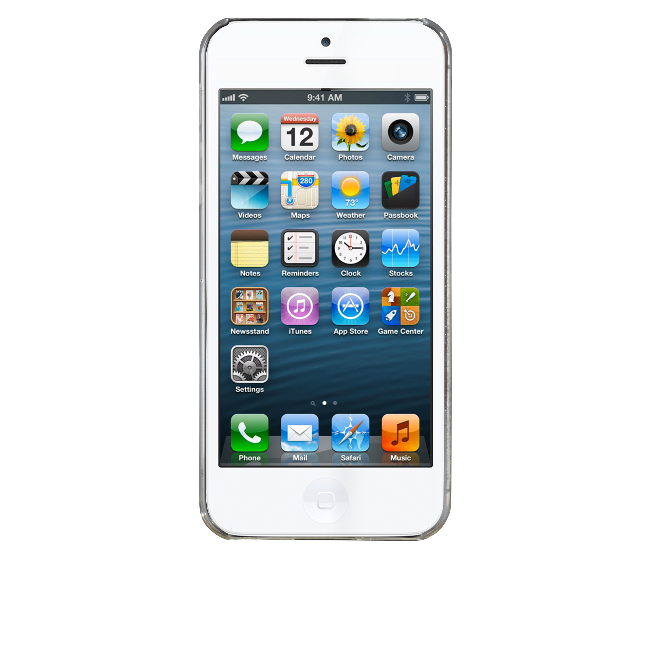
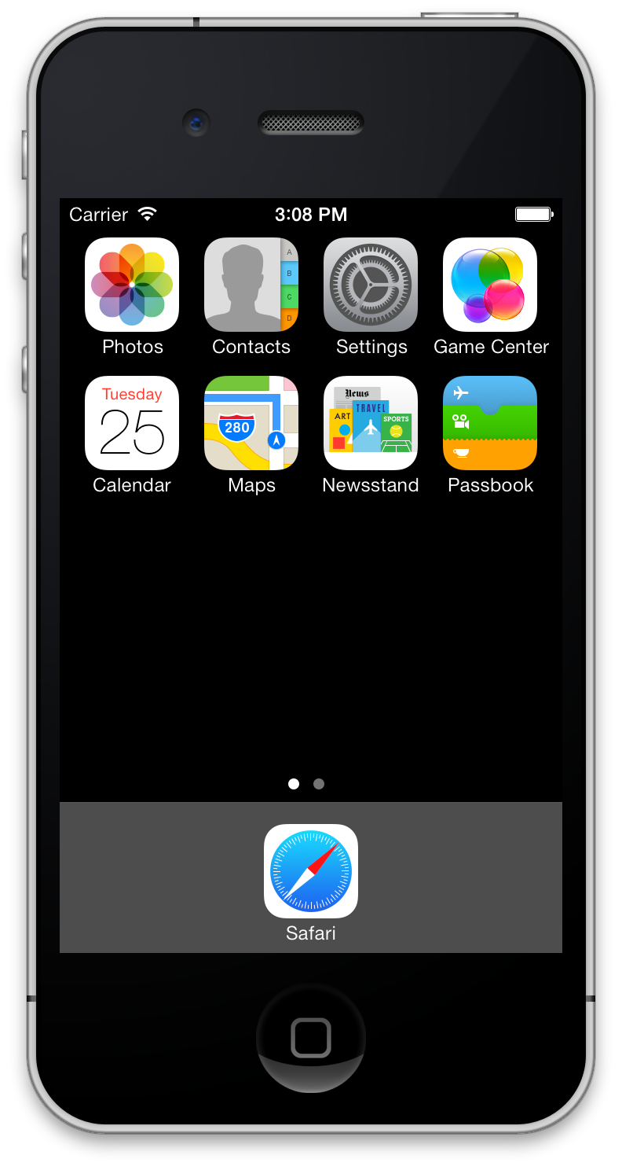
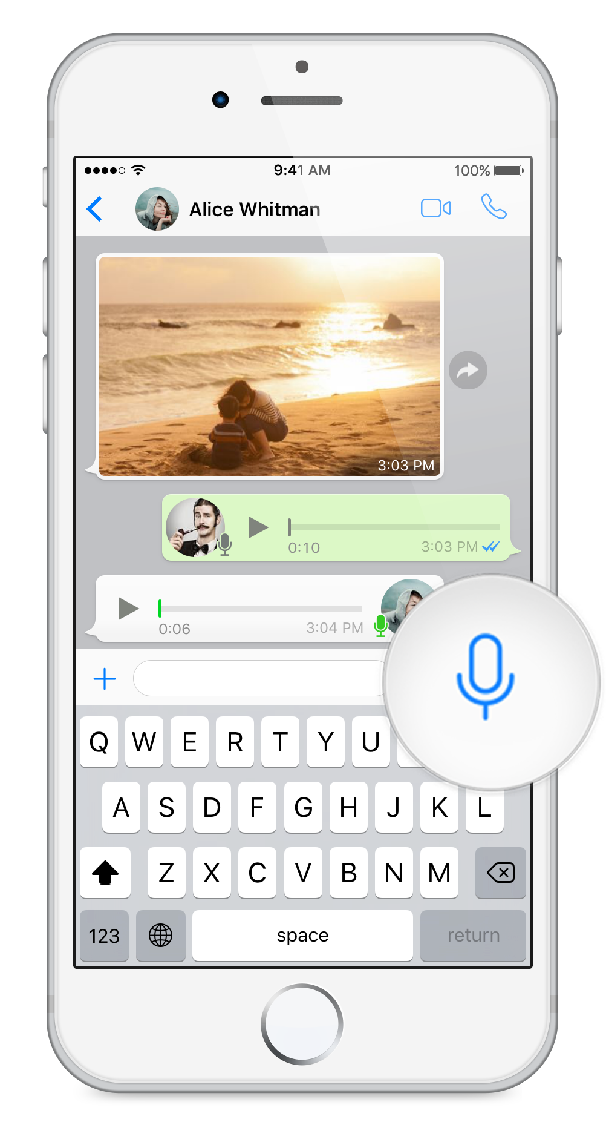
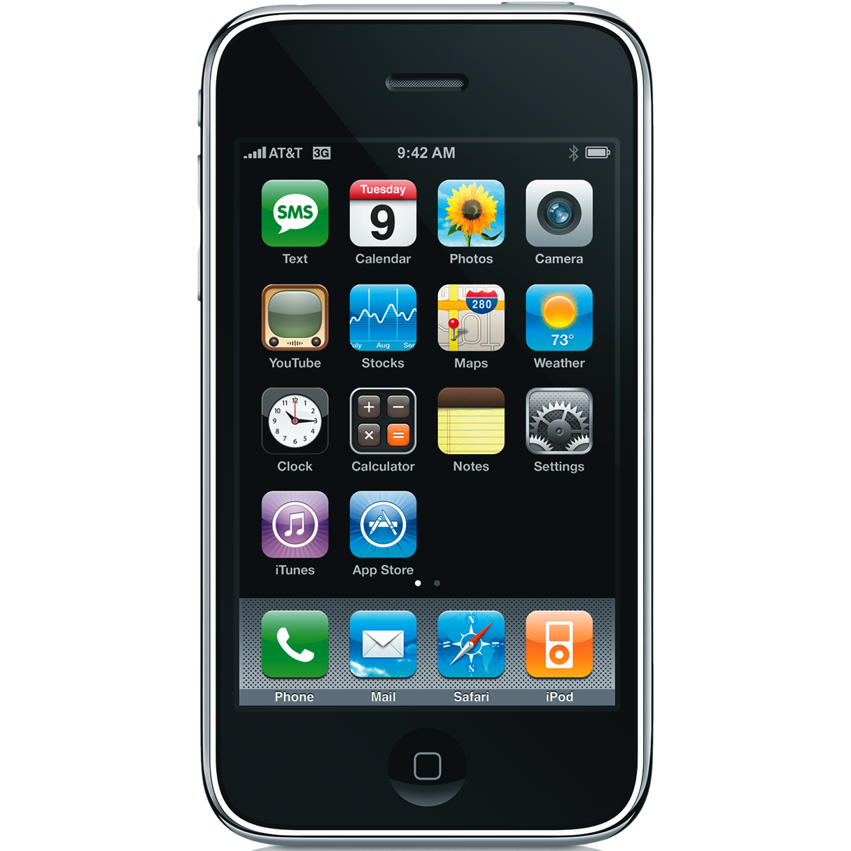
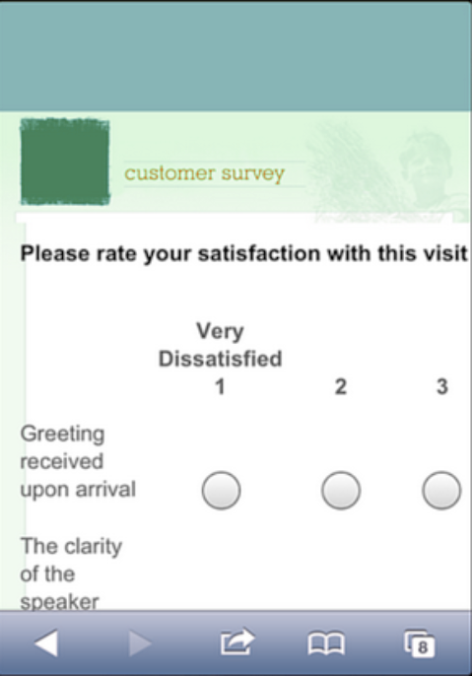
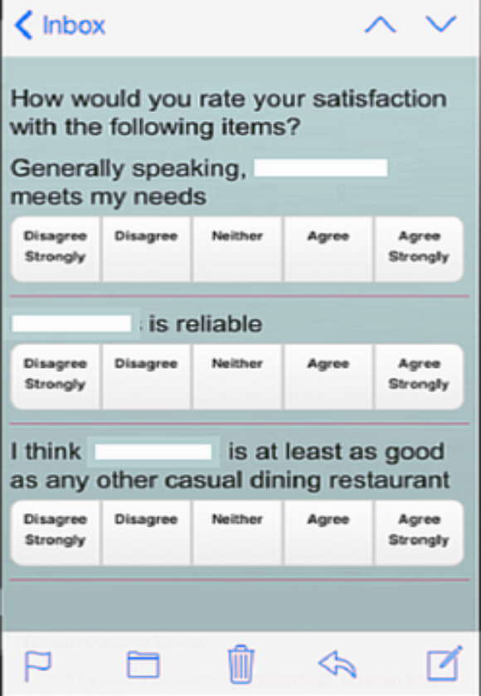
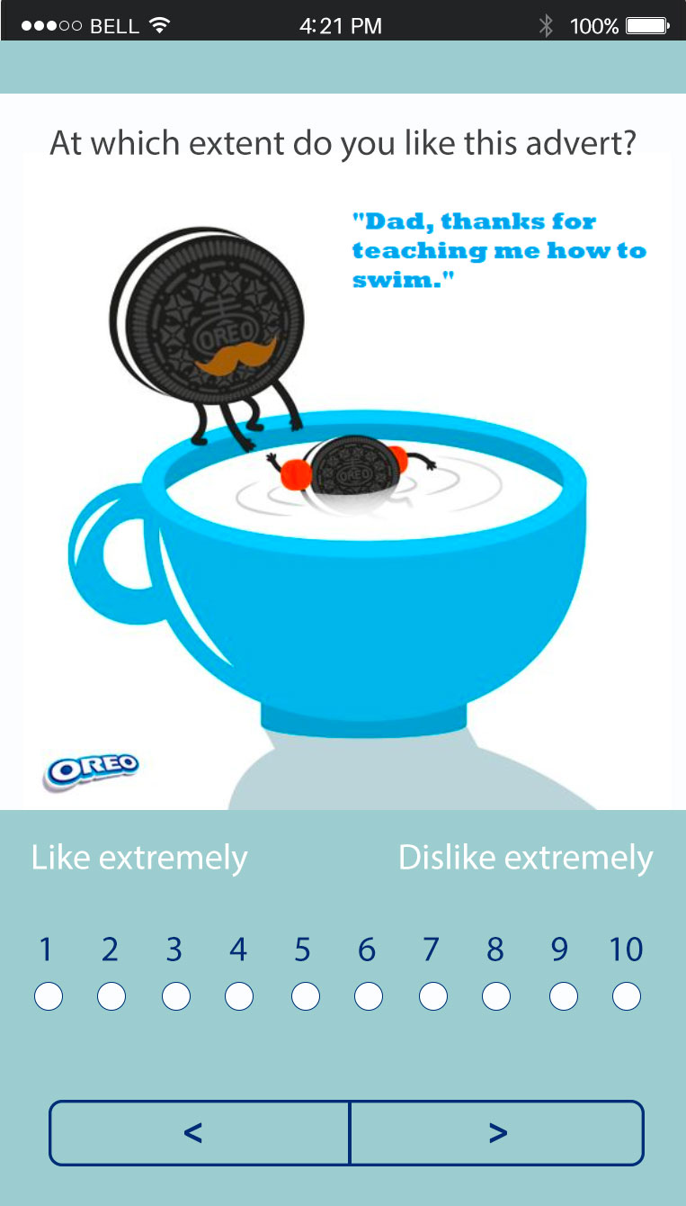
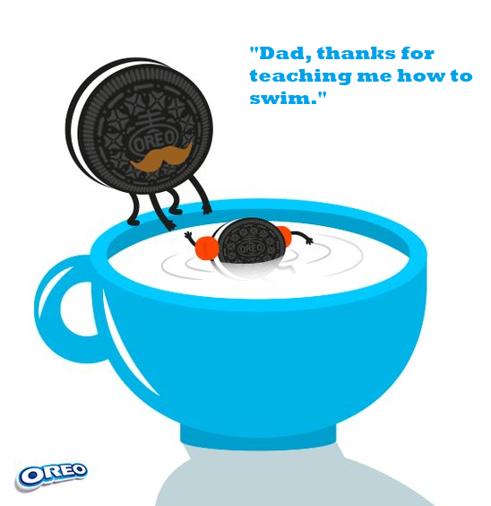
Why do we need to enhance or extend (mobile) web survey data?
Survey
How does this advert make you feel?

Slide 3
Importance of (web) surveys
WHY DO WE NEED TO ENHANCE?

Slide 4
Importance of (web) surveys
WHY DO WE NEED TO ENHANCE?
Surveys are (still) very relevant
Surveys are some of the most frequently used method for collecting data in many disciplines (e.g. sociology, psychology, marketing research)
Results used by key actors to take decisions

Slide 5
Importance of (web) surveys
WHY DO WE NEED TO ENHANCE?
Surveys are (still) very relevant
Surveys are some of the most frequently used method for collecting data in many disciplines (e.g. sociology, psychology, marketing research)
Results used by key actors to take decisions
Web surveys are more and more common
35% spent on research using (mobile) web, vs 11% for telephone and 8% for face-to-face (ESOMAR, 2019).
With pandemic, switch from other modes to web mode even quicker

Slide 6

Importance of (web) surveys
WHY DO WE NEED TO ENHANCE?
Surveys are (still) very relevant
Surveys are the most frequently used method for collecting data in many disciplines (e.g.)
Results used by key actors to take decisions (e.g.)
Web surveys are more and more common
35% spent on research using (mobile) web, vs 11% for telephone and 8% for face-to-face (ESOMAR, 2019).
With pandemic, switch from other modes to web mode even quicker.

Slide 7
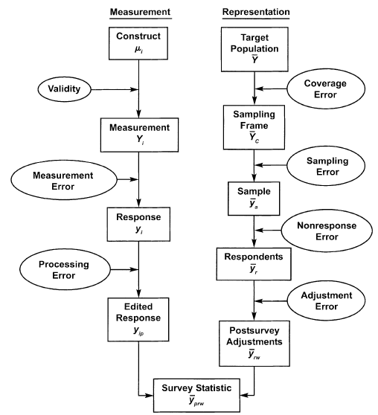
But they suffer from errors
WHY DO WE NEED TO ENHANCE?
Groves, R. M., Fowler Jr, F. J., Couper, M. P., Lepkowski, J. M., Singer, E., & Tourangeau, R. (2011). Survey methodology (Vol. 561). John Wiley & Sons.

Slide 8
But they suffer from errors
WHY DO WE NEED TO ENHANCE?
Groves, R. M., Fowler Jr, F. J., Couper, M. P., Lepkowski, J. M., Singer, E., & Tourangeau, R. (2011). Survey methodology (Vol. 561). John Wiley & Sons.

Slide 9
But they suffer from errors
WHY DO WE NEED TO ENHANCE?
Errors on the side of measurement
People do not know everything surveys ask about
Remembering-self ≠ experiencing-self
To err is human
Lack of effort / satisficing
Social desirability
Groves, R. M., Fowler Jr, F. J., Couper, M. P., Lepkowski, J. M., Singer, E., & Tourangeau, R. (2011). Survey methodology (Vol. 561). John Wiley & Sons.

Slide 10
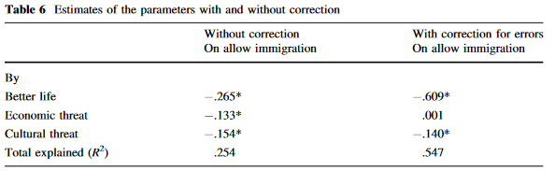
But they suffer from errors
WHY DO WE NEED TO ENHANCE?
Errors on the side of measurement
People do not know everything surveys ask about
Remembering-self ≠ experiencing-self
To err is human
Lack of effort / satisficing
Social desirability
Saris, W. E., & Revilla, M. (2016). Correction for measurement errors in survey research: necessary and possible. Social Indicators Research, 127(3), 1005-1020.

Slide 11
Overall, need to improve measurement for many concepts
WHY DO WE NEED TO ENHANCE?
Lot of knowledge already on survey errors
How to reduce them
How to correct for them
But still large measurement errors

Slide 12
Overall, need to improve measurement for many concepts
WHY DO WE NEED TO ENHANCE?
Lot of knowledge already on survey errors
How to reduce them
How to correct for them
But still large measurement errors
What else can we do?

Slide 13
How could we enhance or extend (mobile) web survey data?
Survey
How does this advert make you feel?

Slide 14
Web surveys bring new opportunities
HOW COULD WE ENHANCE?

Slide 15
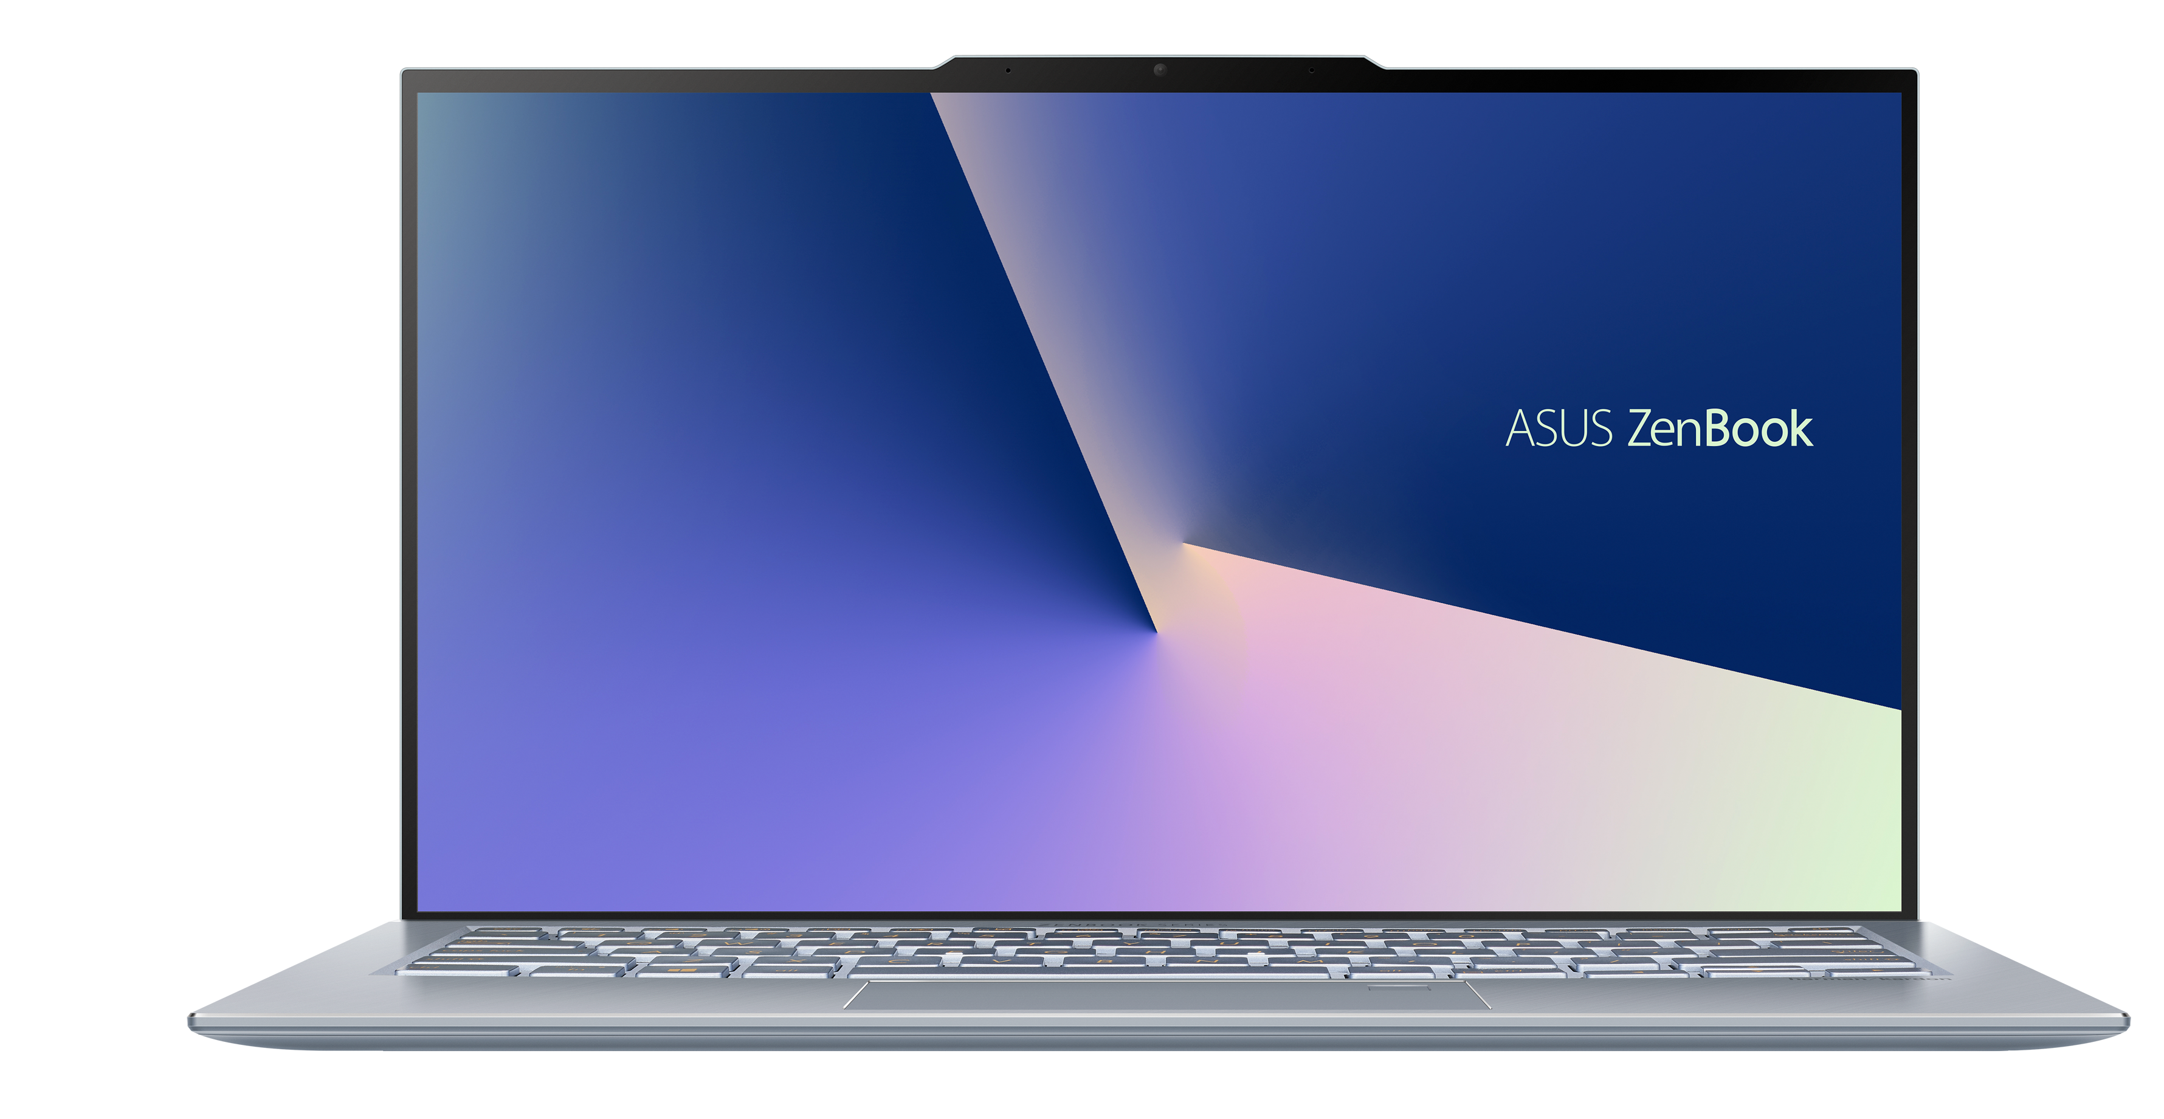
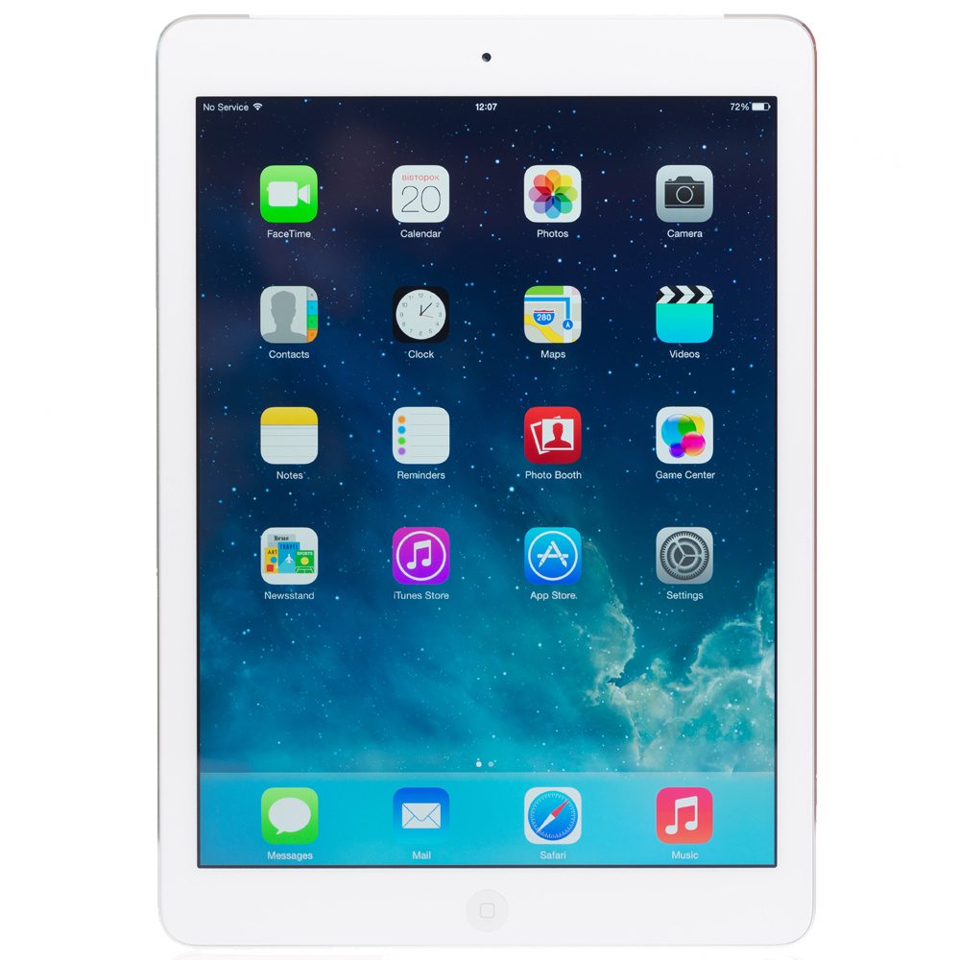
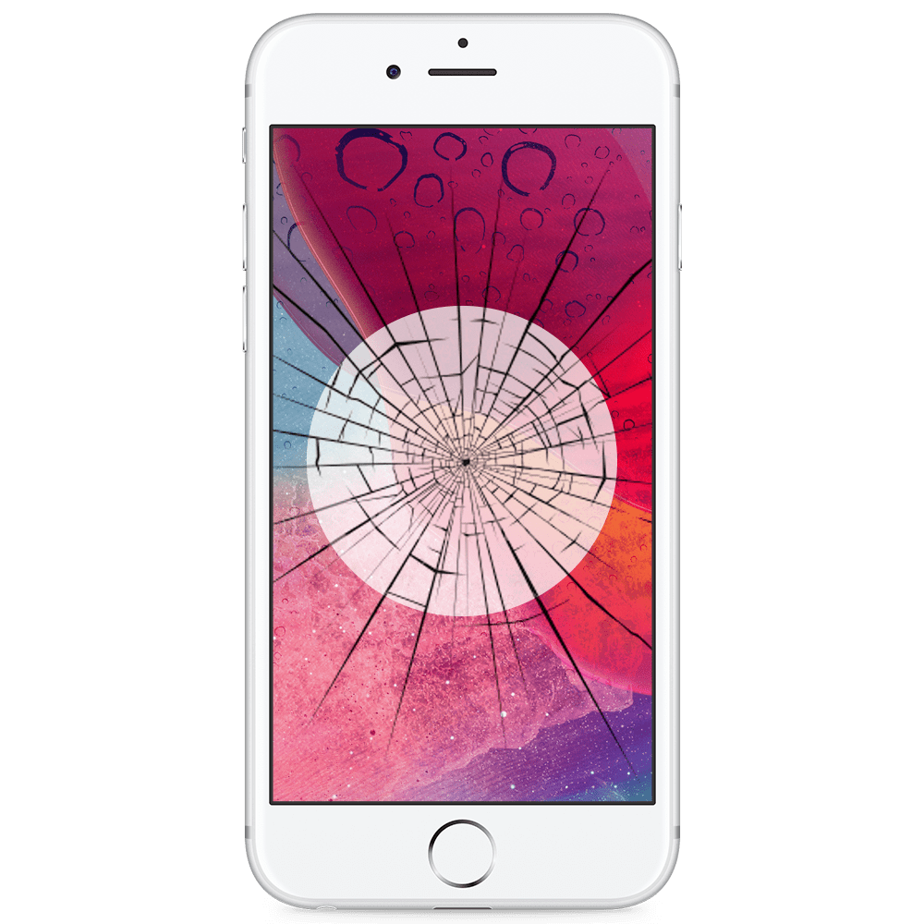
Web surveys bring new opportunities
HOW COULD WE ENHANCE?
Web surveys are essentially multi-device

Slide 16
Web surveys bring new opportunities
HOW COULD WE ENHANCE?
Web surveys are essentially multi-device
Smartphone usage to answer web surveys:
Millennials: 78.8%
Boomers: 36.2 %
Bosch, O. J., Revilla, M., & Paura, E. (2019). Do Millennials differ in terms of survey participation?. International Journal of Market Research, 61(4), 359-365.

Slide 17
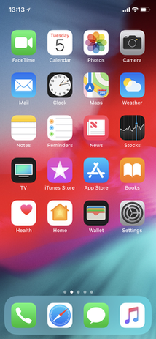
Modern devices are packed with technology that we can use
HOW COULD WE ENHANCE?
Light sensor
Camera
Accelerometer
GPS
Apps
Etc
Microphone

Slide 18
Modern devices are packed with technology that we can use
HOW COULD WE ENHANCE?
We can ask participants to perform new tasks…
Light sensor
Camera
Accelerometer
GPS
Apps
Etc
Microphone

Slide 19
Modern devices are packed with technology that we can use
HOW COULD WE ENHANCE?
…or passively track them
Light sensor
Camera
Accelerometer
GPS
Apps
Etc
Microphone

Slide 20
These new data are already used in substantive research
INTRODUCTION
Meter data
Fake news consumption (e.g., Guess et al. 2020)
Time spent online (e.g., Festic et al. 2021 )
GPS data
Spacial context of physical activity (e.g., Krenn et al., 2011)
Travelling (e.g., Lin & Hsu 2014)
Images
• Mosquitoes presence (e.g., Mosquito Alert project1)
• Consumption diaries (e.g., Kaur et al. 2019)
Voice data
• Level of literacy (ask respondents to read loud some text)
• Survey children’s of panelists

Slide 21
Why using apps and sensors for survey research?
HOW COULD WE ENHANCE?
Researchers
Reduce measurement issues
(e.g. objective)
Provide new data
Massive and granular
Real time
Participants
Reduce time
Reduce efforts
More enjoyable

Slide 22
But expected disadvantages as well
HOW COULD WE ENHANCE?
Selection bias in who participates
Privacy issues
Technical limitations
Lack of skills
New types of errors
Technology errors
Coding and processing errors
Device-related errors
More complex and expensive
New skills needed for analyses
Need to create new infrastructures
Dependence on private companies
Ethical/data protection issues

Slide 23
But expected disadvantages as well
HOW COULD WE ENHANCE?
Selection bias in who participates
Privacy issues
Technical limitations
Lack of skills
New types of errors
Technology errors
Coding and processing errors
Device-related errors
More complex and expensive
New skills needed for analyses
Need to create new infrastructures
Dependence on private companies
Ethical/data protection issues

Slide 24
But expected disadvantages as well
HOW COULD WE ENHANCE?
Selection bias in who participates
Privacy issues
Technical limitations
Lack of skills
New types of errors
Technology errors
Coding and processing errors
Device-related errors
More complex and expensive
New skills needed for analyses
Need to create new infrastructures
Dependence on private companies
Ethical/data protection issues

Slide 25
OUR RESEARCH

Slide 26


Focus on 2 new types of data
OUR RESEARCH
Visual data
Photos taken in-the-moment
Images saved on the device
Screenshots
Voice data
Dictation
Voice-recordings

Slide 27
3 studies
OUR RESEARCH
Visual data
Bosch, Revilla and Paura, 2019
Spain & Mexico, non-experimental
Compliance
Skills
Costs
Bosch, Revilla, Qureshi and Hohne, 2021
Germany, survey experiment
Nonresponse
Completion time
Survey evaluation
Voice data
Revilla, Couper, Bosch and Asensio, 2020
Spain, survey experiment
Nonresponse
Technical problems
Data quality
Survey evaluation

Slide 28
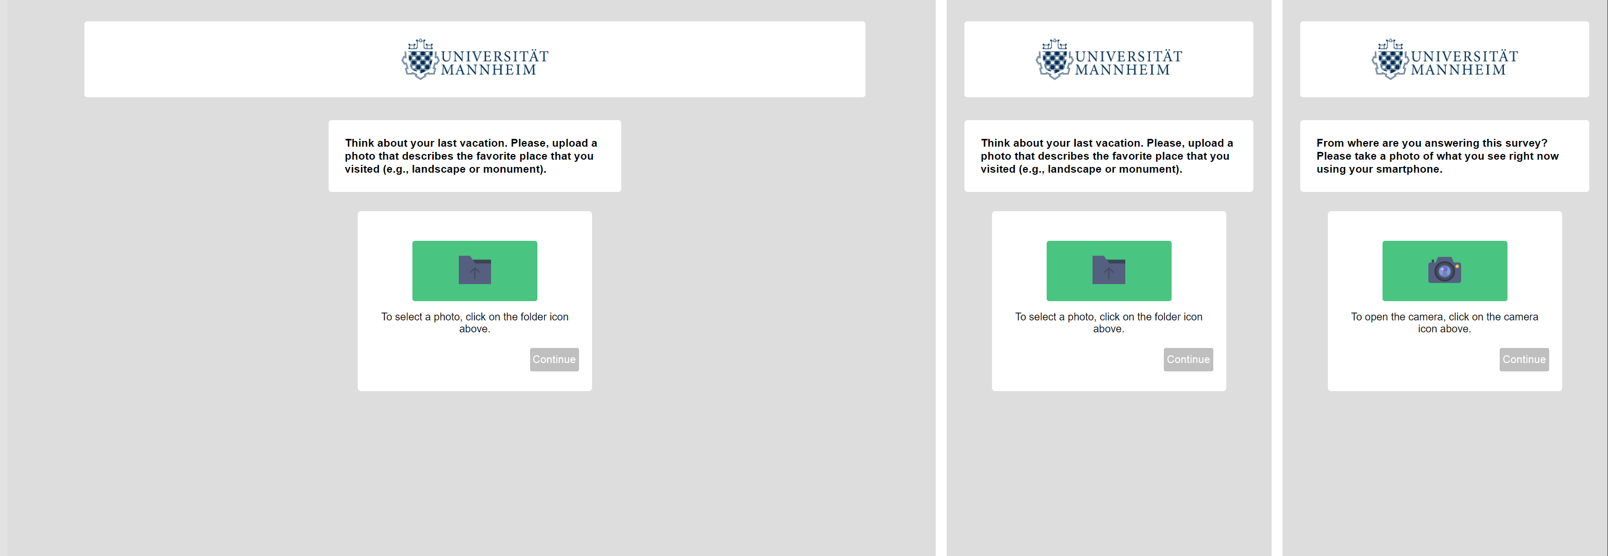
VISUAL DATA

Slide 29
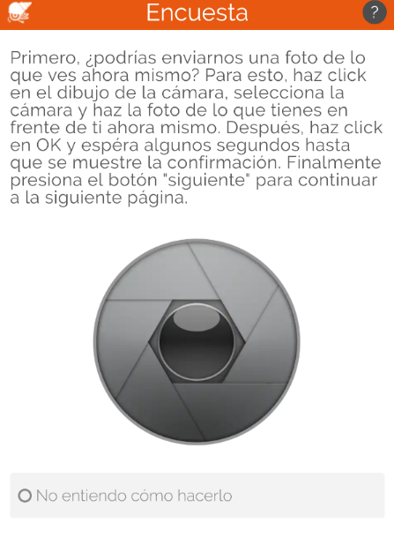
Visual data
RESULTS
Bosch, Revilla and Paura (2019)
No experimental design
Asked respondents in Spain and Mexico at the very end of a survey to send 2 images:
A picture of their surroundings taken in the moment
An image of something that made them laugh already saved on their smartphone
Bosch, O. J., Revilla, M., & Paura, E. (2019). Answering mobile surveys with images: an exploration using a computer vision API. Social Science Computer Review, 37(5), 669-683.

Slide 30
Visual data
RESULTS
Bosch, Revilla and Paura (2019)
No experimental design
Asked respondents in Spain and Mexico at the very end of a survey to send 2 images:
A picture of their surroundings taken in the moment
An image of something that made them laugh already saved on their smartphone
Is it feasible to ask participants to answer open-ended questions with images?
Bosch, O. J., Revilla, M., & Paura, E. (2019). Answering mobile surveys with images: an exploration using a computer vision API. Social Science Computer Review, 37(5), 669-683.

Slide 31
Visual data
RESULTS
Bosch, Revilla and Paura (2019)
Percentage of Respondents Answering in Line, Answering not in Line, Not Understanding How to Do It, and Skipping
Note:* indicates significant differences between tasks at p<.05
Bosch, O. J., Revilla, M., & Paura, E. (2019). Answering mobile surveys with images: an exploration using a computer vision API. Social Science Computer Review, 37(5), 669-683.

Slide 32
Visual data
RESULTS
Bosch, Revilla and Paura (2019)
Percentage of Respondents Answering in Line, Answering not in Line, Not Understanding How to Do It, and Skipping
Note:* indicates significant differences between tasks at p<.05
Bosch, O. J., Revilla, M., & Paura, E. (2019). Answering mobile surveys with images: an exploration using a computer vision API. Social Science Computer Review, 37(5), 669-683.

Slide 33
Visual data
RESULTS
Bosch, Revilla and Paura (2019)
Percentage of Respondents Answering in Line, Answering not in Line, Not Understanding How to Do It, and Skipping
Note:* indicates significant differences between tasks at p<.05
Bosch, O. J., Revilla, M., & Paura, E. (2019). Answering mobile surveys with images: an exploration using a computer vision API. Social Science Computer Review, 37(5), 669-683.

Slide 34
Visual data
RESULTS
Bosch, Revilla and Paura (2019)
How to code all these images to extract workable information? Computer vision
Bosch, O. J., Revilla, M., & Paura, E. (2019). Answering mobile surveys with images: an exploration using a computer vision API. Social Science Computer Review, 37(5), 669-683.

Slide 35
Visual data
RESULTS
Bosch, Revilla and Paura (2019)
How to code all these images to extract workable information? Computer vision
We assessed the adequacy of using a computer vision API (Google Vision)
Bosch, O. J., Revilla, M., & Paura, E. (2019). Answering mobile surveys with images: an exploration using a computer vision API. Social Science Computer Review, 37(5), 669-683.

Slide 36
Visual data
RESULTS
Bosch, Revilla and Paura (2019)
How to code all these images to extract workable information? Computer vision
We assessed the adequacy of using a computer vision API (Google Vision)
Cost x 1,818 images = Human: 553€ / Google Vision: 2.50€
Time x 1,818 = Human: 35 hours / Google Vision: <5 minutes
Bosch, O. J., Revilla, M., & Paura, E. (2019). Answering mobile surveys with images: an exploration using a computer vision API. Social Science Computer Review, 37(5), 669-683.

Slide 37
Visual data
RESULTS
Bosch, Revilla and Paura (2019)
How to code all these images to extract workable information? Computer vision
We assessed the adequacy of using a computer vision API (Google Vision)
Cost x 1,818 images = Human: 553€ / Google Vision: 2.50€
Time x 1,818 = Human: 35 hours / Google Vision: <5 minutes
Between 52% and 65% of the images similarly coded by the human coder and Google Vision
Bosch, O. J., Revilla, M., & Paura, E. (2019). Answering mobile surveys with images: an exploration using a computer vision API. Social Science Computer Review, 37(5), 669-683.

Slide 38
Visual data
RESULTS
Bosch, Revilla, Qureshi and Hohne (2021)
Compare
Asking to type an answer
Asking to send an image
Asking to send an image + motivational message

Slide 39
Visual data
RESULTS
Bosch, Revilla, Qureshi and Hohne (2021)
Compare
Asking to type an answer
Asking to send an image
Asking to send an image + motivational message
What is the impact of asking for images on response rates, completion time and question evaluation?
Can we improve all these indicators by adding motivational messages?
Is there an interaction between the device used and the effect of asking for images?

Slide 40
Visual data
RESULTS
Bosch, Revilla, Qureshi and Hohne (2021)
2x3 between subject experimental design
Group name | Device type | Answer format | Motivational message
PC-Text | PC | Text | No
PC-Image | PC | Image | No
PC-ImagePush | PC | Image | Yes
S-Text | Smartphone | Text | No
S-Image | Smartphone | Image | No
S-ImagePush | Smartphone | Image | Yes
Bosch, O. J., Revilla, M., Hohne, J. K., & Qureshi, D. (2021). A new experiment on the use of images to answer web survey questions. Journal of the Royal Statistical Society Series A. FORTHCOMING.

Slide 41
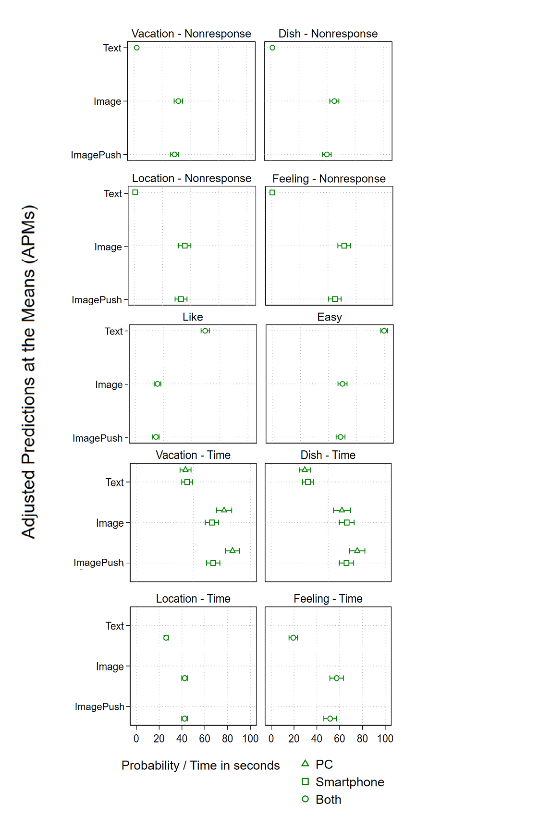
Visual data
RESULTS
Bosch, Revilla, Qureshi and Hohne (2021)
Asking for images:
Increases the probability of item nonresponse (26-51.5 p.points higher probability)
Increases completion times (21.8 to 39.9 seconds more)
Decreases the probability of enjoying and finding questions easy (30 p.p lower probability of liking and finding the questions easy)
Motivation messages have no effect on these indicators
There is no interaction between asking for images and using a PC or smartphone to answer
Bosch, O. J., Revilla, M., Hohne, J. K., & Qureshi, D. (2021). A new experiment on the use of images to answer web survey questions. Journal of the Royal Statistical Society Series A. FORTHCOMING.

Slide 42
Visual data
RESULTS
Bosch, Revilla, Qureshi and Hohne (2021)
Asking for images:
Increases the probability of item nonresponse (26-51.5 p.points higher probability)
Increases completion times (21.8 to 39.9 seconds more)
Decreases the probability of enjoying and finding questions easy (30 p.p lower probability of liking and finding the questions easy)
Motivation messages have no effect on these indicators
There is no interaction between asking for images and using a PC or smartphone to answer
Bosch, O. J., Revilla, M., Hohne, J. K., & Qureshi, D. (2021). A new experiment on the use of images to answer web survey questions. Journal of the Royal Statistical Society Series A. FORTHCOMING.

Slide 43
Visual data
RESULTS
Bosch, Revilla, Qureshi and Hohne (2021)
Asking for images:
Increases the probability of item nonresponse (26-51.5 p.points higher probability)
Increases completion times (21.8 to 39.9 seconds more)
Decreases the probability of enjoying and finding questions easy (30 p.p lower probability of liking and finding the questions easy)
Motivation messages have no effect on these indicators
There is no interaction between asking for images and using a PC or smartphone to answer
Bosch, O. J., Revilla, M., Hohne, J. K., & Qureshi, D. (2021). A new experiment on the use of images to answer web survey questions. Journal of the Royal Statistical Society Series A. FORTHCOMING.

Slide 44
Visual data
RESULTS
Bosch, Revilla, Qureshi and Hohne (2021)
Asking for images:
Increases the probability of item nonresponse (26-51.5 p.points higher probability)
Increases completion times (21.8 to 39.9 seconds more)
Decreases the probability of enjoying and finding questions easy (30 p.p lower probability of liking and finding the questions easy)
Motivation messages have no effect on these indicators
There is no interaction between asking for images and using a PC or smartphone to answer
Bosch, O. J., Revilla, M., Hohne, J. K., & Qureshi, D. (2021). A new experiment on the use of images to answer web survey questions. Journal of the Royal Statistical Society Series A. FORTHCOMING.

Slide 45
Visual data
RESULTS
Bosch, Revilla, Qureshi and Hohne (2021)
Asking for images:
Increases the probability of item nonresponse (26-51.5 p.points higher probability)
Increases completion times (21.8 to 39.9 seconds more)
Decreases the probability of enjoying and finding questions easy (30 p.p lower probability of liking and finding the questions easy)
essages have no effect on these indicators
There is no interaction between asking for images and using a PC or smartphone to answer
Motivation messages have no effect on these indicators
There is no interaction between asking for images and using a PC or smartphone to answer
Bosch, O. J., Revilla, M., Hohne, J. K., & Qureshi, D. (2021). A new experiment on the use of images to answer web survey questions. Journal of the Royal Statistical Society Series A. FORTHCOMING.

Slide 46
Visual data
RESULTS
Bosch, Revilla, Qureshi and Hohne (2021)
Asking for images:
Increases the probability of item nonresponse (26-51.5 p.points higher probability)
Increases completion times (21.8 to 39.9 seconds more)
Decreases the probability of enjoying and finding questions easy (30 p.p lower probability of liking and finding the questions easy)
essages have no effect on these indicators
There is no interaction between asking for images and using a PC or smartphone to answer
Motivation messages have no effect on these indicators
Interaction between asking for images and using a PC or smartphone to answer is not really relevant
Bosch, O. J., Revilla, M., Hohne, J. K., & Qureshi, D. (2021). A new experiment on the use of images to answer web survey questions. Journal of the Royal Statistical Society Series A. FORTHCOMING.

Slide 47
VOICE DATA
How does this advert make you feel?

Slide 48
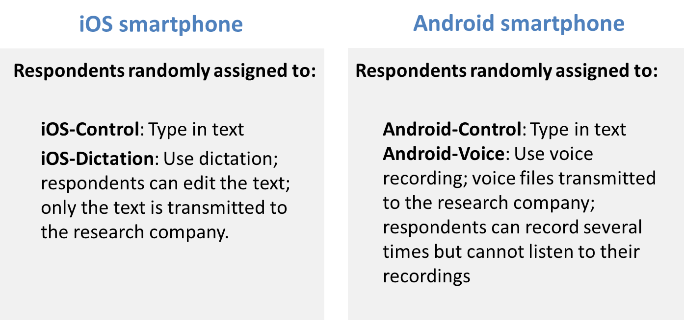
Voice data
RESULTS
Revilla, Couper, Bosch and Asensio, 2020
Revilla, M., Couper, M. P., Bosch, O. J., & Asensio, M. (2020). Testing the use of voice input in a smartphone web survey. Social Science Computer Review, 38(2), 207-224.

Slide 49
Voice data
RESULTS
Revilla, Couper, Bosch and Asensio, 2020
What is the impact of asking participants to answer with voice dictation or recording on response rates, reported technical issues and question evaluation?
Are voice dictation and voice recording answers longer and richer than typed answers?
Revilla, M., Couper, M. P., Bosch, O. J., & Asensio, M. (2020). Testing the use of voice input in a smartphone web survey. Social Science Computer Review, 38(2), 207-224.

Slide 50
Voice data
RESULTS
Revilla, Couper, Bosch and Asensio, 2020
How well does it work to ask respondents to use voice input options to answer open questions?
Item nonresponse (% did not answer all 6 experimental questions)
Android-Voice: 63.3%
iOS-Dictation: 3.3%
Control groups: 1.5% in Android; 3.0% in iOS
Problems reported
Android-Voice: 26.3%
iOS-Dictation: 8.7%
Control groups: 5.4% in Android and 6.0% in iOS
Revilla, M., Couper, M. P., Bosch, O. J., & Asensio, M. (2020). Testing the use of voice input in a smartphone web survey. Social Science Computer Review, 38(2), 207-224.

Slide 51
Voice data
RESULTS
Revilla, Couper, Bosch and Asensio, 2020
How well does it work to ask respondents to use voice input options to answer open questions?
Item nonresponse (% did not answer all 6 experimental questions)
Android-Voice: 63.3%
iOS-Dictation: 3.3%
Control groups: 1.5% in Android; 3.0% in iOS
Problems reported
Android-Voice: 26.3%
iOS-Dictation: 8.7%
Control groups: 5.4% in Android and 6.0% in iOS
Revilla, M., Couper, M. P., Bosch, O. J., & Asensio, M. (2020). Testing the use of voice input in a smartphone web survey. Social Science Computer Review, 38(2), 207-224.

Slide 52
Voice data
RESULTS
Revilla, Couper, Bosch and Asensio, 2020
How well does it work to ask respondents to use voice input options to answer open questions?
Item nonresponse (% did not answer all 6 experimental questions)
Android-Voice: 63.3%
iOS-Dictation: 3.3%
Control groups: 1.5% in Android; 3.0% in iOS
Problems reported
Android-Voice: 26.3%
iOS-Dictation: 8.7%
Control groups: 5.4% in Android and 6.0% in iOS
Revilla, M., Couper, M. P., Bosch, O. J., & Asensio, M. (2020). Testing the use of voice input in a smartphone web survey. Social Science Computer Review, 38(2), 207-224.

Slide 53
Voice data
RESULTS
Revilla, Couper, Bosch and Asensio, 2020
For those answering, effect of using voice input on:
Data quality
Longer and more elaborated answers for Android-Voice
Fewer valid answers and a smaller amount of information for iOS-Dictation
Survey evaluation
More negative ratings for Android-Voice
No difference for iOS-Dictation
Revilla, M., Couper, M. P., Bosch, O. J., & Asensio, M. (2020). Testing the use of voice input in a smartphone web survey. Social Science Computer Review, 38(2), 207-224.

Slide 54
Voice data
RESULTS
Revilla, Couper, Bosch and Asensio, 2020
For those answering, effect of using voice input on:
Data quality
Longer and more elaborated answers for Android-Voice
Fewer valid answers and a smaller amount of information for iOS-Dictation
Survey evaluation
More negative ratings for Android-Voice
No difference for iOS-Dictation
Revilla, M., Couper, M. P., Bosch, O. J., & Asensio, M. (2020). Testing the use of voice input in a smartphone web survey. Social Science Computer Review, 38(2), 207-224.

Slide 55
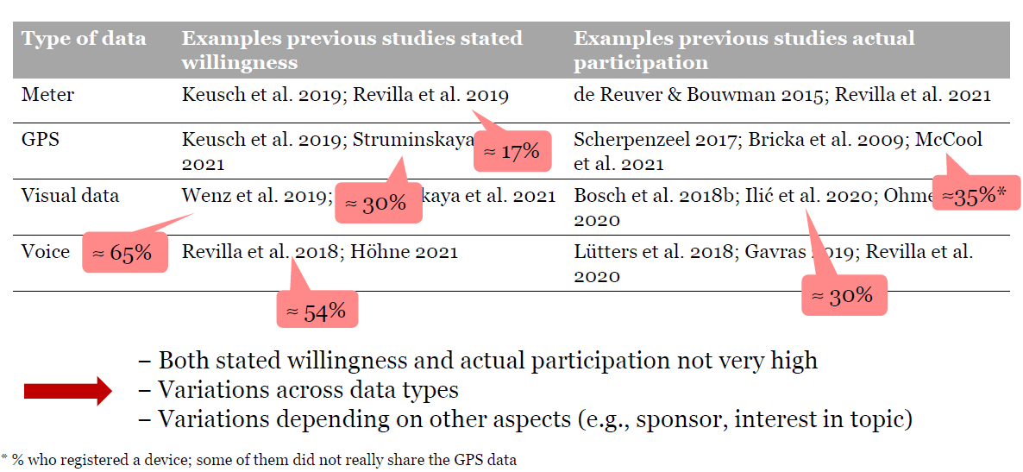
How does this compare to other research & data types?
RESULTS

Slide 56
Take-home messages
CONCLUSIONS
Device sensors and apps bring many opportunities to survey research
However, drawbacks must be carefully considered beforehand
Images & Voice
In general we see that for both images and voice item nonresponse and completion times will increase, while survey evaluation will be worse.
There is the potential to improve measurement quality, but this must overcome the added errors

Slide 57
Need more research
CONCLUSIONS
Still a lot to be done
Create frameworks
Apply to key issues
Provide guidelines to help researchers use these new data types
Etc.
But potentially broad applications
Health: obesity (visual data); depression (meter)
Social sciences: travelling (GPS); feelings about elections results (voice)
Economics: spending (visual data); online banking (meter)
Etc.

Slide 58
Thanks!
Questions?
Oriol J. Bosch|PhD Candidate, The London School of Economics
ORIOL J. BOSCH | THE LONDON SCHOOL OF ECONOMICS / RECSM-UPF
o.bosch-jover@lse.ac.uk
orioljbosch
https://orioljbosch.com/

